Slide 1
PROJECT TITLE: Mobile App For Direct Access For Farmers
CSE7101- Capstone Project
Review-2
Batch Number: COM_20
Roll no Student Name
20221COM0097 ANUSH BG
20221COM0088 THANUSH G GOWDA
20221COM0204 ADARSHA DA
Under the Supervision of,
Dr. Sudha P
Associate Professor
School of Computer Science and Engineering
Presidency University
Name of the Program: B.Tech. Computer Engineering (Artificial Intelligence And Machine Learning)
Name of the HoD: Dr Pallavi R
Name of the Program Project Coordinator: Ms. Benitha Christinal J
Name of the School Project Coordinators: Dr. Sampath A K , Dr. Geetha A

Slide 2
Content
Problem Statement & Number
Abstract
Literature Survey
Objectives
Existing Methods and Drawbacks
Proposed Method & Feasibility Study
Architecture Diagram
Modules
Hardware and Software Details
Timeline (Gantt Chart)
References

Slide 3
Problem Statement Number: PSCS_281
Organization: Ministry of Agriculture And Farmers Welfare
Category :Software
Problem Description : Background: Farmers often face challenges in accessing markets, leading to lower income due to middlemen. This gap restricts their ability to sell produce at fair prices. Description: Create a mobile application that connects farmers directly with consumers and retailers. The app should include features for listing produce, negotiating prices, and managing transactions, thereby reducing dependence on intermediaries. Expected Solution: A user-friendly mobile platform that enables farmers to showcase their products and connect with buyers directly, enhancing their income potential.

Slide 4
Abstract
The agricultural sector in India faces persistent challenges due to farmers’ dependence on intermediaries for marketing produce. This reliance reduces profit margins and limits transparency in transactions. To overcome these issues, the proposed project, under the Ministry of Agriculture and Farmers Welfare, introduces a mobile application that directly connects farmers with consumers and retailers. The platform serves as a digital marketplace where farmers can list crops, negotiate prices, and manage transactions securely.
The app includes multilingual support to reach farmers across different regions and integrates voice-enabled features such as Speech-to-Text (STT) through Google Keyboard and Text-to-Speech (TTS) for negotiation messages. These features improve accessibility, especially for semi-literate farmers. Core functionalities include crop listing, negotiation, digital payments, and order tracking, ensuring benefits for both farmers and buyers through fair pricing and reliable sourcing.
From a feasibility perspective, the app employs a React Native frontend, FastAPI backend, and Node.js with Supabase DB, ensuring scalability and secure data handling. Economically, it leverages open-source tools and potential revenue models, while socially it enhances farmer income, fosters digital inclusion, and builds trust in agricultural markets.

Slide 5
Literature Survey
Kishan et al. (2025) – Mobile App for Direct Market Access
Proposed a user-friendly app to connect farmers with consumers and retailers, focusing on secure transactions and digital listings [1].
Limitation: Limited to basic features; lacks AI-driven insights and multilingual support.
Bhavani et al. (2025) – Direct Farmer-to-Market Mobile App
Developed a mobile app supporting transactions, showing improvements in farmer income [2].
Limitation: Limited scalability and no integration with transport/logistics.
Tati et al. (2025) – Multi-Service Farmer App
Designed an app connecting farmers to markets, transport, and fertilizer shops [3].
Limitation: Broader scope but less specialization; complexity in adoption by rural users.
Sughasini et al. (2024) – Negotiation-Based Market Access
Introduced a scalable platform enabling direct negotiation between farmers and buyers [4].
Limitation: Focused mainly on pricing transparency; lacks digital payment integration.
Gomez et al. (2023) – AgroTIC (Crop Monitoring + Market Access)
Combined IoT-enabled crop monitoring with direct market listing; emphasized data-driven insights [5].
Limitation: Relies on IoT infrastructure, not widely available in rural regions.
Mwakalinga et al. (2024) – eKichabi v2 (Tanzania)
Dual-platform agricultural directory improving access to information and reducing transaction costs [6].
Limitation: Regional focus; lacks advanced transaction and payment features.

Slide 6
Literature Survey(contd…)
7. Vyas et al. (2023/24) – Flutter + Firebase Platform
Developed a cross-platform app for farmer–consumer interaction, ensuring scalability and cloud storage [7].
Limitation: Dependent on stable internet connectivity; limited offline features.
8.Kumar et al. (2020) – Regional Language Android App
Designed a mobile platform in local languages to improve inclusivity for less literate farmers [8].
Limitation: Lacks advanced features like analytics, AI, or secure payment support.
9. S. M. et al. (2020) – Agricultural Marketing App
Android app supporting listing, search, and crop purchases with a simple UI [9].
Limitation: Early-stage prototype; not field-tested for large-scale deployment.
10.Samuel et al. (2024/25) – AgroLLM (Conversational AI for Farmers)
Leveraged Large Language Models (LLMs) to support buyer–seller communication and Q&A [10].
Limitation: High computational requirements; rural connectivity and cost challenges
.
11.Farmers E-Commerce Mobile Application – IJCRT (2023)
Highlights a digital marketplace for farmers called HarvestHub, focused on direct transactions between farmers and buyers [6}.
Limitation: Basic marketplace features; lacks AI-driven insights and multilingual support.

Slide 7
Objectives
Provide farmers a direct digital marketplace.
Increase farmer income through fair pricing.
Enable secure digital payments & transaction management.
Support multilingual & voice-enabled accessibility.
Expand market reach for farmers’ produce.
Build scalable system using React Native, FastAPI & Supabase DB.
Ensure low-cost, sustainable, and open-source solution.
Align with SDG 9 – Innovation & Infrastructure.

Slide 8
Existing Models and Drawbacks
Existing Models – Common Features:
Provide digital platforms for direct farmer–buyer transactions
Improve market access and income opportunities for farmers
Enable listing, search, and basic negotiation features
Support regional inclusivity through mobile applications
Common Drawbacks:
Lack of multilingual support and inclusivity
Limited or no logistics and payment integration
Mostly prototype stage, not tested at scale
Low awareness and adoption among rural farmers

Slide 9
Proposed Method & Feasibility Study
Proposed Methodology
User-Centric Design: Simple and intuitive UI tailored for farmers and retailers
Multilingual Support: App available in English + regional languages for inclusivity
Voice Interaction:
  Text-to-Speech (TTS): Reads out messages during negotiations for better accessibility
  Speech-to-Text (STT): Google Keyboard used for input, enabling farmers to speak instead of typing
Core Features:
  Farmer: Add/Delete crops, manage listings, negotiate with buyers
  Retailer: Browse, negotiate, and purchase crops directly
  Secure digital payments & order tracking
Backend: Cloud-based API + database for scalability and faster access

Slide 10
Proposed Method & Feasibility Study
Feasibility Study
Technically viable with React Native (cross-platform), FastAPI backend, Supabase DB, and Google STT(for negotiations)
Operationally practical as farmers use voice support and retailers get real-time.
Economically feasible with low-cost open-source tools and revenue via transaction fees/premium features
Socially impactful by boosting farmer income, promoting digital inclusion, and ensuring transparency

Slide 11
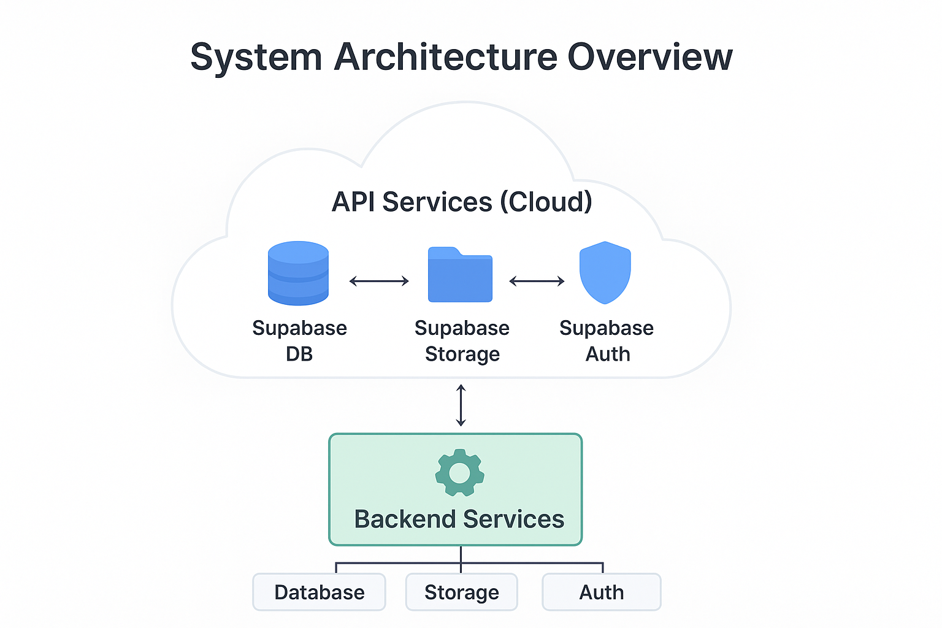
Architecture Diagram

Slide 12
Modules
User Authentication & Role Management
Farmer/Retailer login & signup
Produce Listing Module
Add crops with details, quantity, images
Negotiation & Order Module
Direct negotiation, order placement, and tracking
Payment & Transaction Module
Demo digital payments with receipts

Slide 13
Software & Hardware Requirements
Software:-
React Native (Mobile App)
Node.js
FastAPI / Spring Boot (Backend API)
PostgreSQL (Database)
Supabase (Authentication, Storage)
GitHub (Version Control & Collaboration)
Hardware:-
Farmers/Retailers: Android or iOS Smartphone (≥2GB RAM, Internet 3G/4G, GPS-enabled)
Developers: PC/Laptop (i5 or higher, 8GB RAM, SSD, 64-bit OS, Internet)
Optional: Basic Server/Cloud hosting for backend services

Slide 14
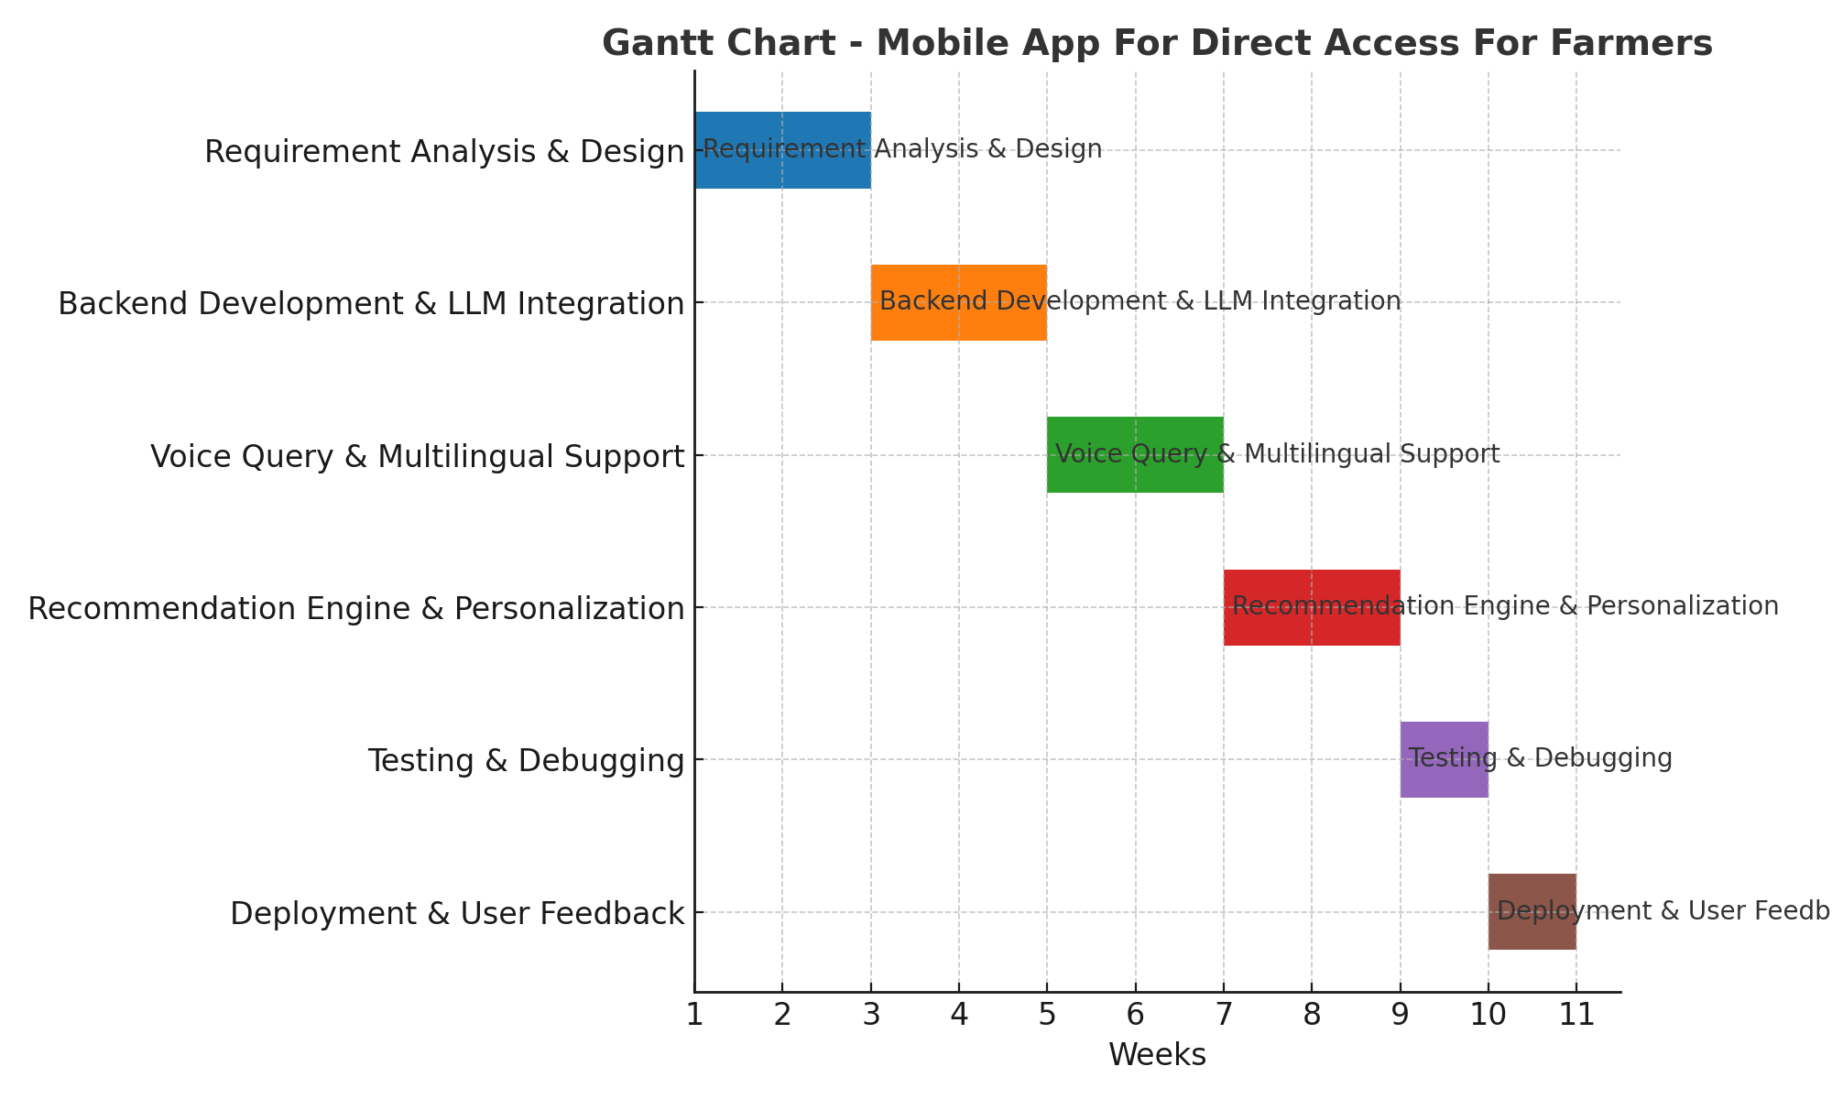
Timeline (Gantt Chart)

Slide 15
References
Base Paper:
[1] E. S. Kishan, H. B. Tarun, and M. S. Prasad, “Mobile App for Direct Market Access for Farmers,” International Journal of Innovative Research in Technology (IJIRT), vol. 11, no. 11, pp. 45–50, Apr. 2025.
Other References:
[2] A. D. Bhavani, M. S. Varshini, P. P. Reddy, and V. C. Varshith, “Mobile Application for Direct Market Access for Farmers,” International Journal of Engineering and Management Sciences (IJEMS), vol. 6, no. 3, pp. 112–118, Mar. 2025.
[3] T. S. Tati, O. K. Landage, and R. K. Sangle, “Mobile Application for Farmer to Get Direct Access to Market, Transport, Fertilizer Shops,” International Journal for Research in Applied Science and Engineering Technology (IJRASET), vol. 13, no. 4, pp. 2330–2336, Apr. 2025.
[4] K. Sughasini, R. S. Gowda, and P. M. Reddy, “Mobile App for Direct Market Access for Farmers,” Journal of Emerging Technologies and Innovative Research (JETIR), vol. 11, no. 12, pp. 89–95, Dec. 2024.
[5] J. P. Gomez, A. M. Lozano, and C. A. Lopez, “AgroTIC: A Mobile Application for Crop Monitoring and Direct Market Access,” arXiv preprint, arXiv:2305.12418, 2023.
[6] R. C. Mwakalinga, A. C. Kaijage, and P. E. Mushi, “eKichabi v2: A Dual-Platform Mobile Agricultural Directory for Farmers in Tanzania,” arXiv preprint, arXiv:2403.09980, 2024.

Slide 16
References (contd…)
[7] R. Vyas, R. Rameja, V. Arora, and V. Sahu, “A Mobile Platform for Direct Market Access to Farmers Using Flutter and Firebase,” Geetanjali Institute of Technical Studies, India, 2023/2024.
[8] K. T. G. Kumar, G. K. Abhishek, and P. G. K. Karthikeya, “Android App for Farmers to Sell Crops in Regional Language,” International Research Journal of Engineering and Technology (IRJET), 2020.
[9] S. M., R. G. S., S. M. Holla, P. S., S. Prabhanjan, and S. C. Sumana, “Android Application on Agricultural Marketing,” International Research Journal of Engineering and Technology (IRJET), 2020.
[10] D. J. Samuel, I. Skarga-Bandurova, D. Sikolia, and M. Awais, “AgroLLM: Connecting Farmers via LLMs,” ResearchGate, 2024/2025. [Online]. Available: https://www.researchgate.net/publication/386423586

Slide 17


